Slide 1
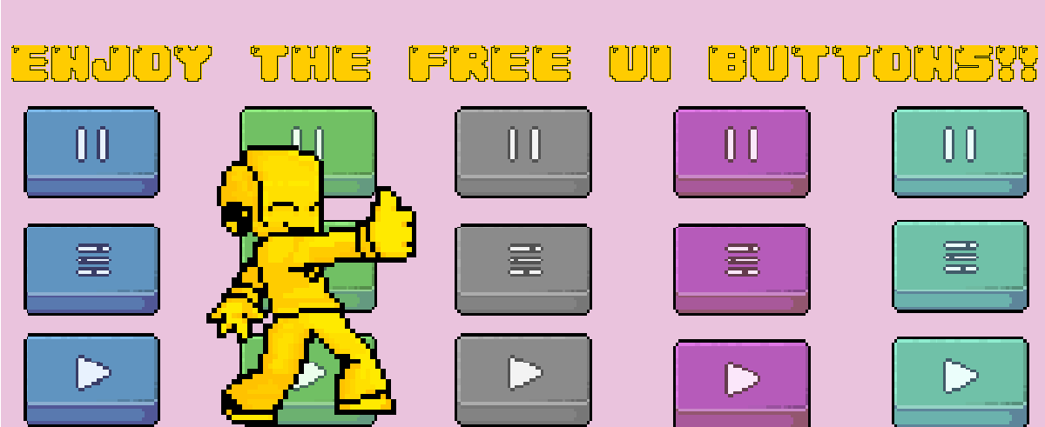
Thank You! For download my first ever asset

Slide 2
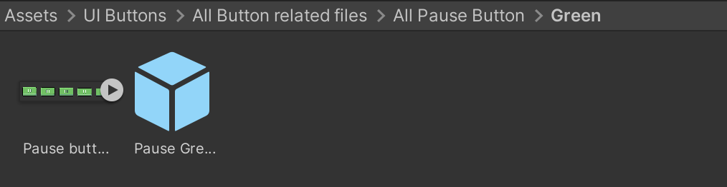
If you are happy to use the prefabs provided.
Example:
Green Pause Button.
If you just follow to directory, you should be fine! These are attached along with each sprite sheet for a full animation.

Slide 3

What Software?
You can really use any drawing software. I personally use ASEPRITE (primarily for its price 20 USD). Alternatively, you can use PIXEL STUDIO which is free to use and is available on both phone and pc!

Slide 4
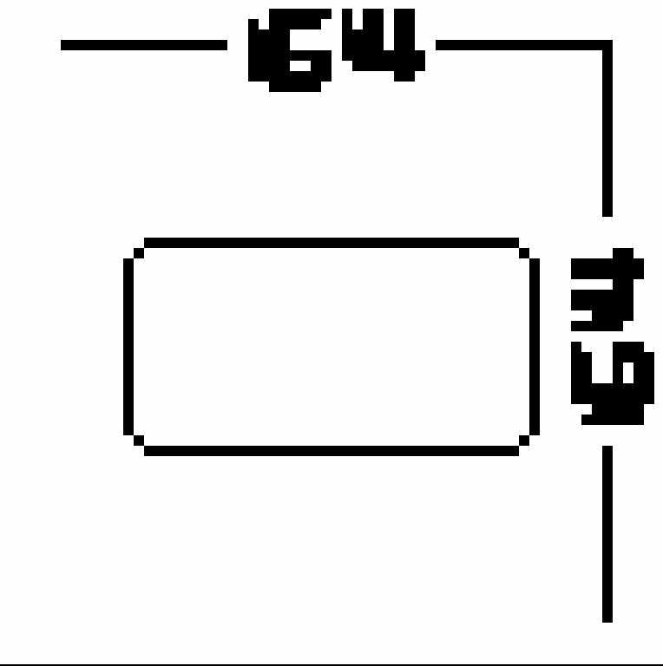
If you want to make your own?
First make a 64x64 canvas
Then draw a simple shape with soft edges.

Slide 5
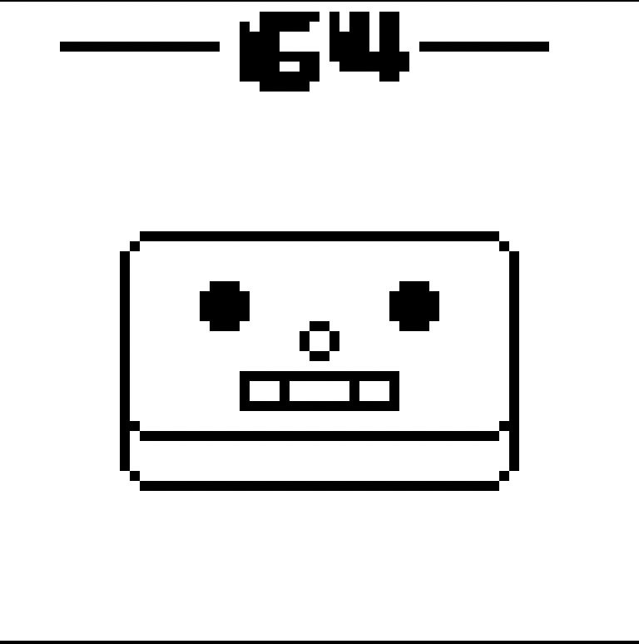
Copy bottom half and place beneath original
I gave mine a face rather than and Icon

Slide 6
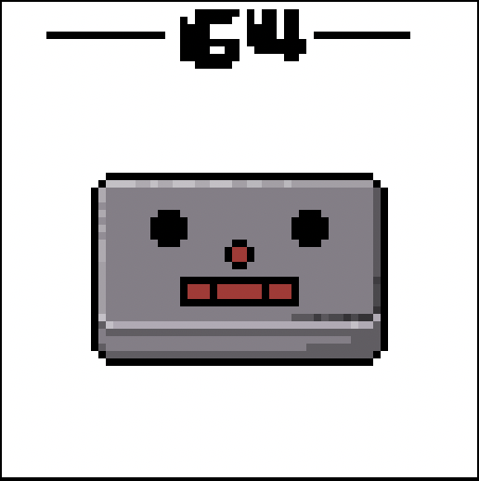
Time to colour!
For the sake of this tutorial, I have not spent much time on how it looks.

Slide 7
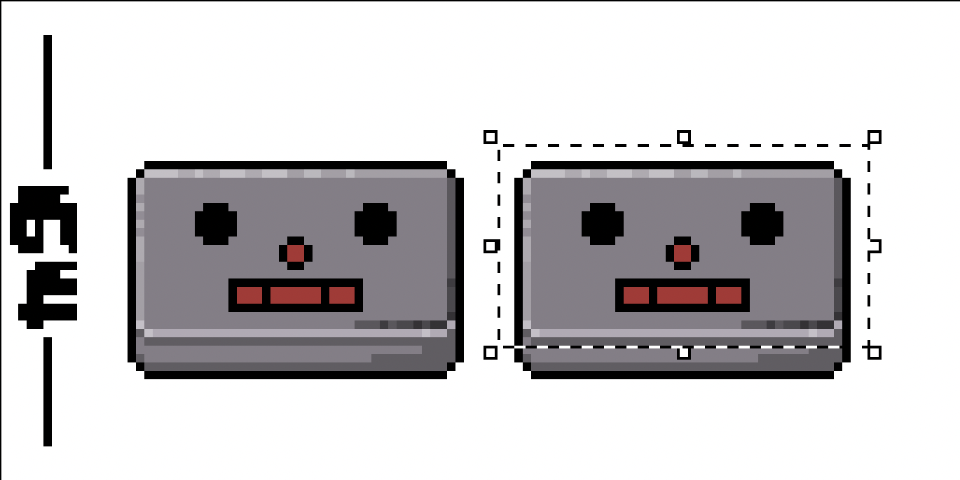
Animation time!
There are many ways to approach this. I Personally make a copy of the original which will be the next frame in my animation.
You want to take you selection box tool and go around the top face of your button. (Ensure you do not go past your bottom corner) Example of missing the edge in picture above.
After face has been selected, drag the section down by one pixel. The full movement of range for the button depends on how much length you have given the bottom part.

Slide 8
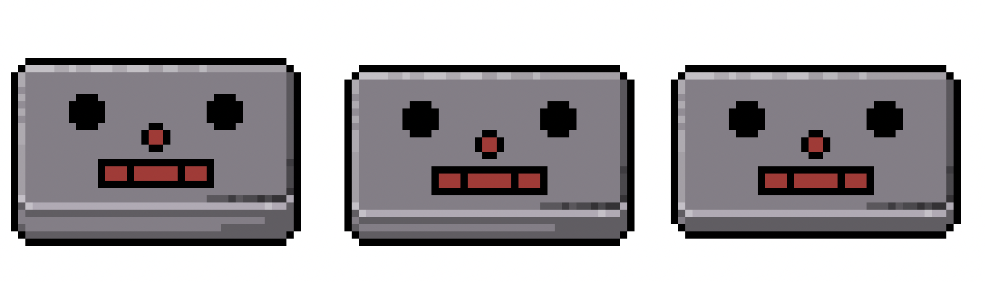
Repeat previous step until you have made the button make a full movement
As you can see within my asset pack, I have only used 5 total frames. To be honest I would consider that the best amount as it still abides to the animation quality of old 16-bit games.
This example only has 3 frames.

Slide 9
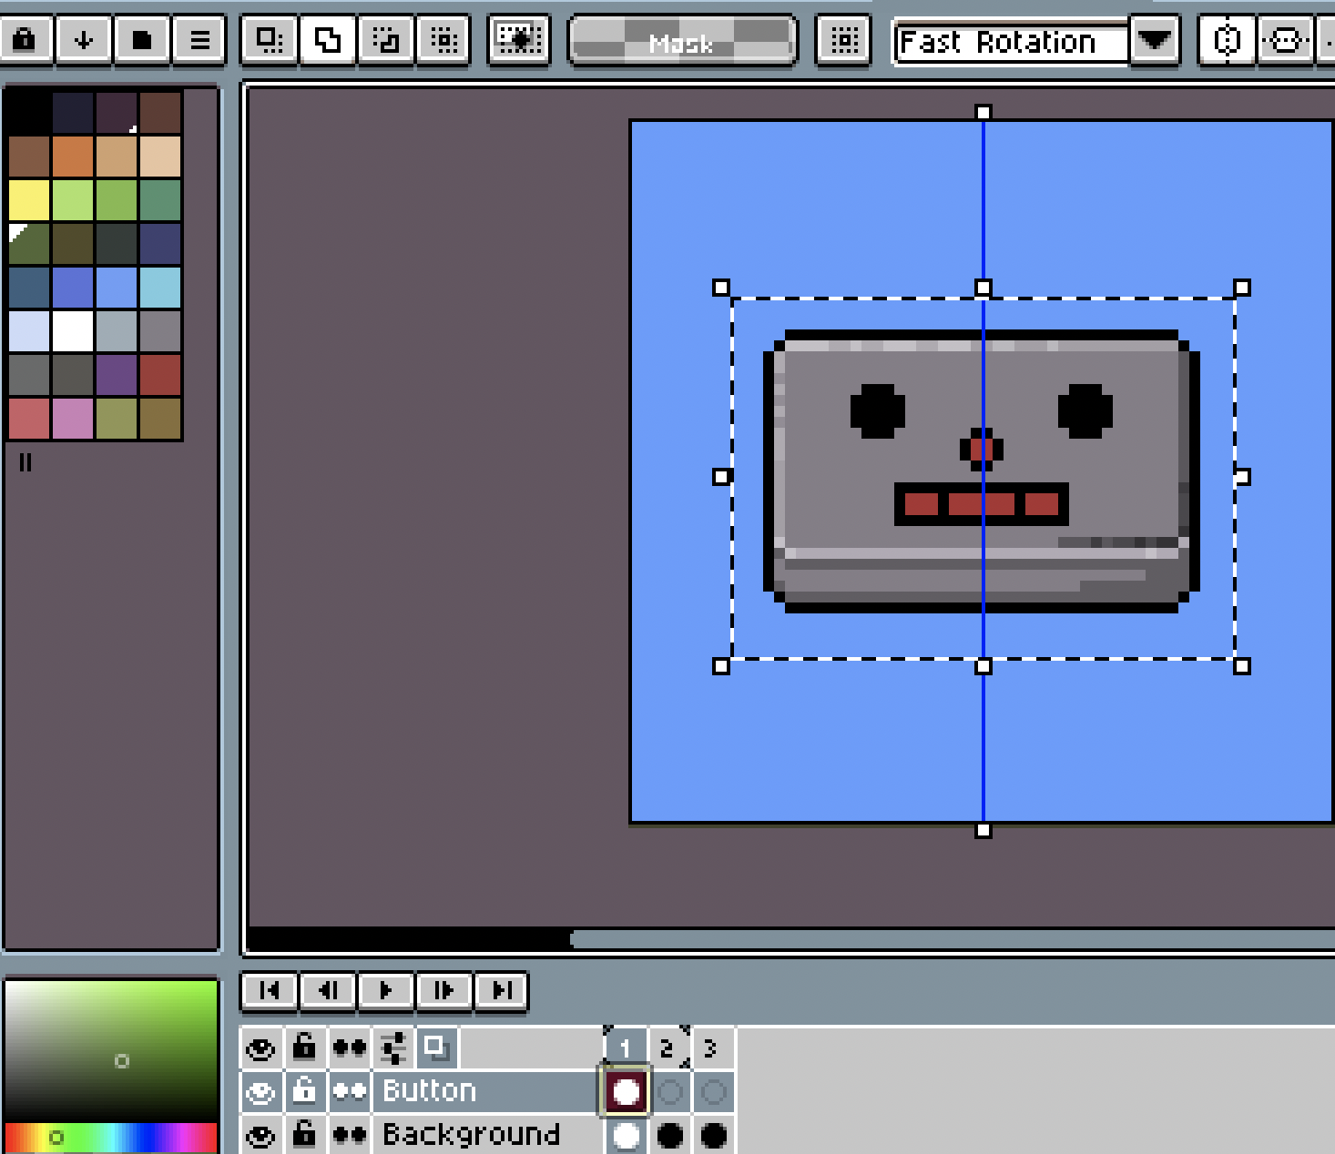
Getting it ready to export
After all sprites have been drawn. I like to make and new canvas (64x64) which I use to place each sprite on all necessary frames.

Slide 10
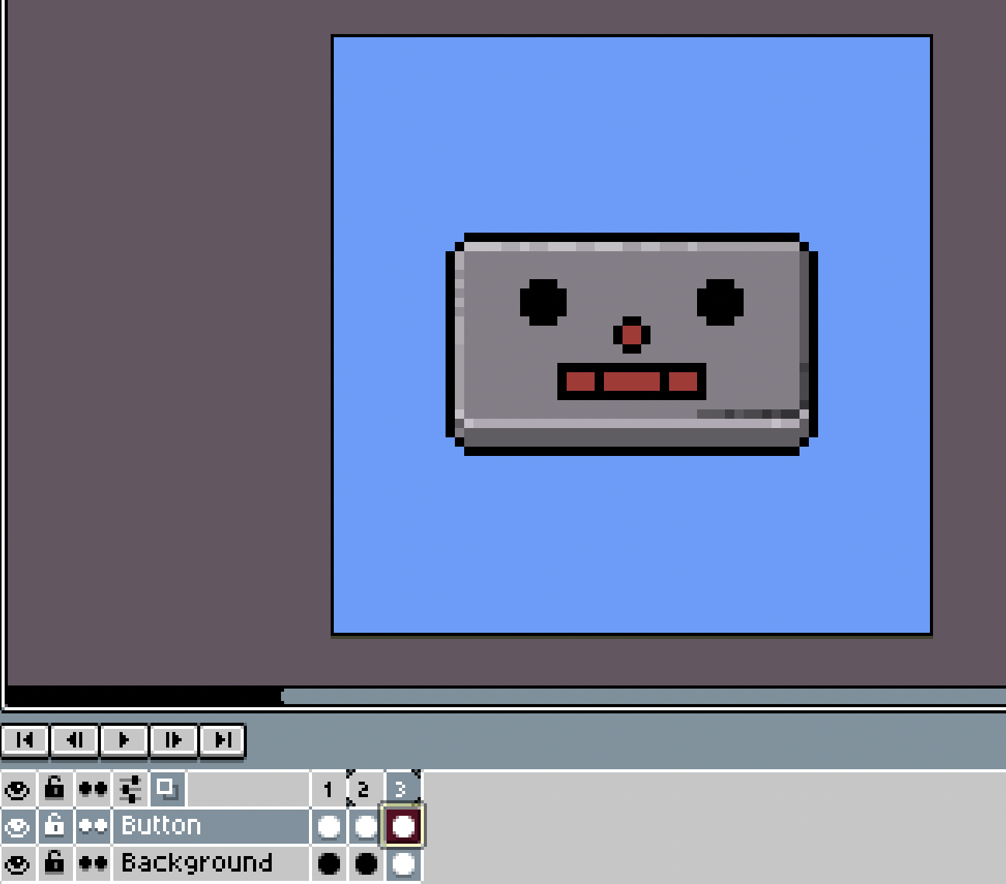
Finished Animation
Once you have layered all your frames. It is time to export the animation. Make sure when you have been following these steps you have kept your button on its own layer.

Slide 11
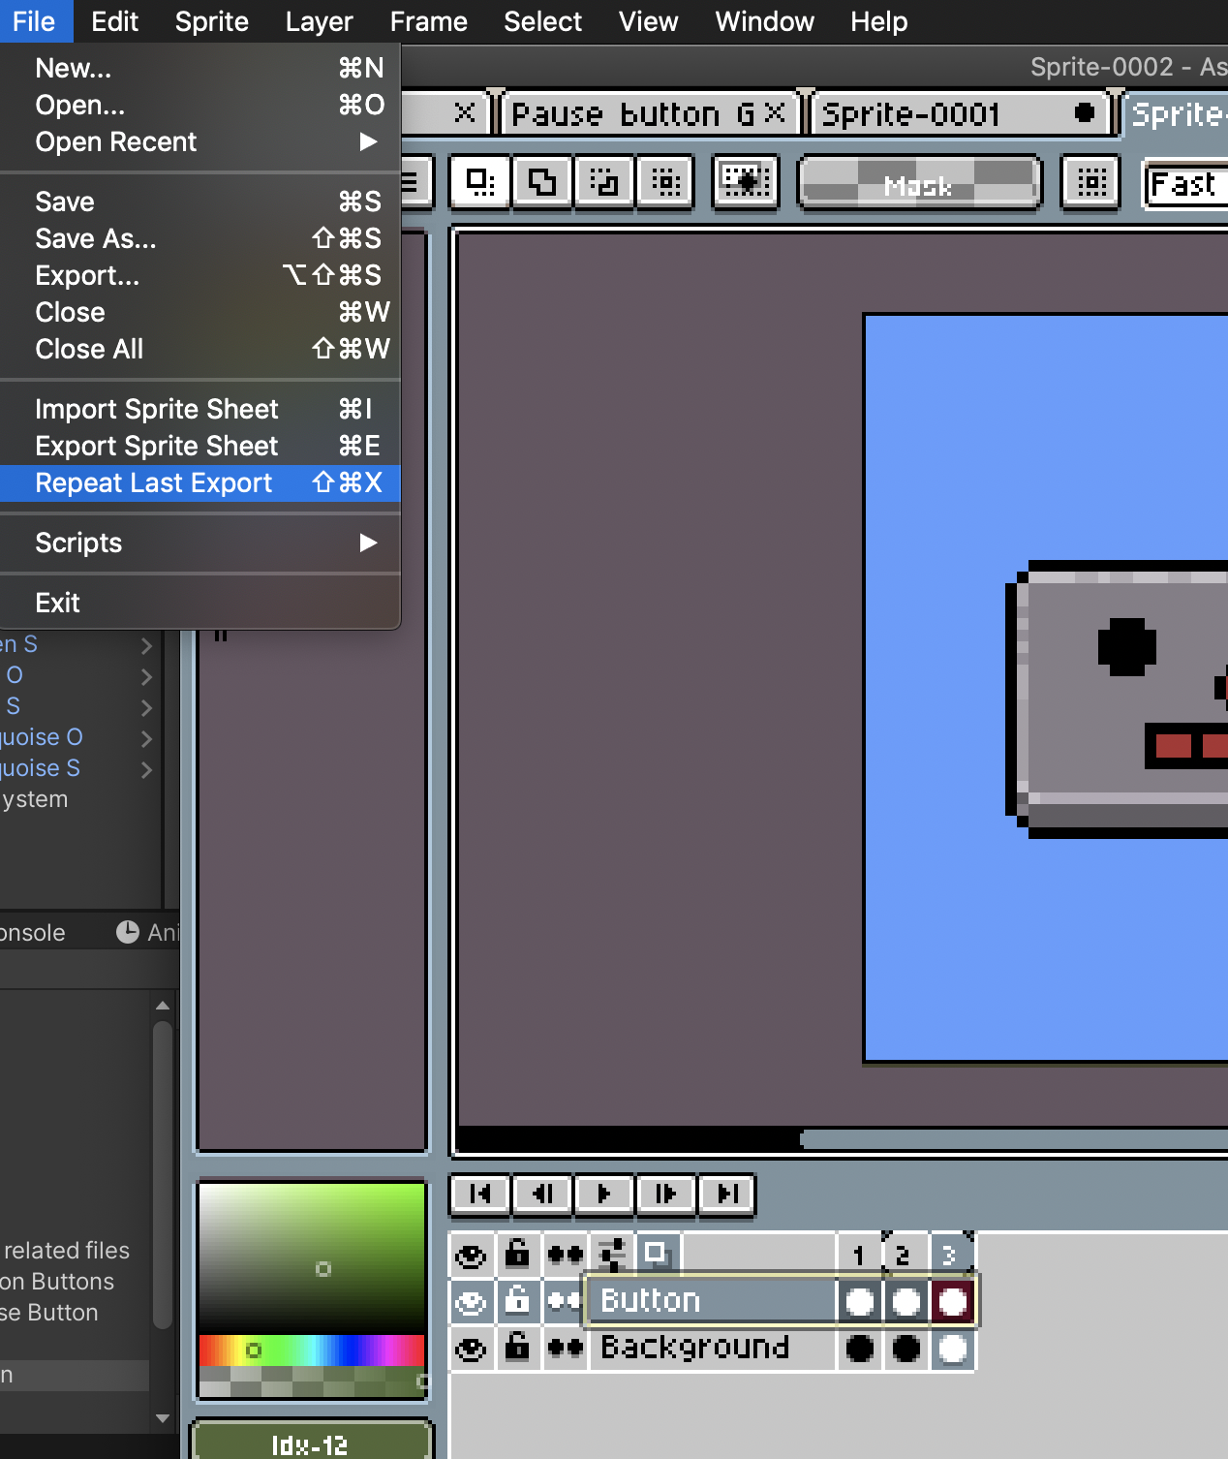
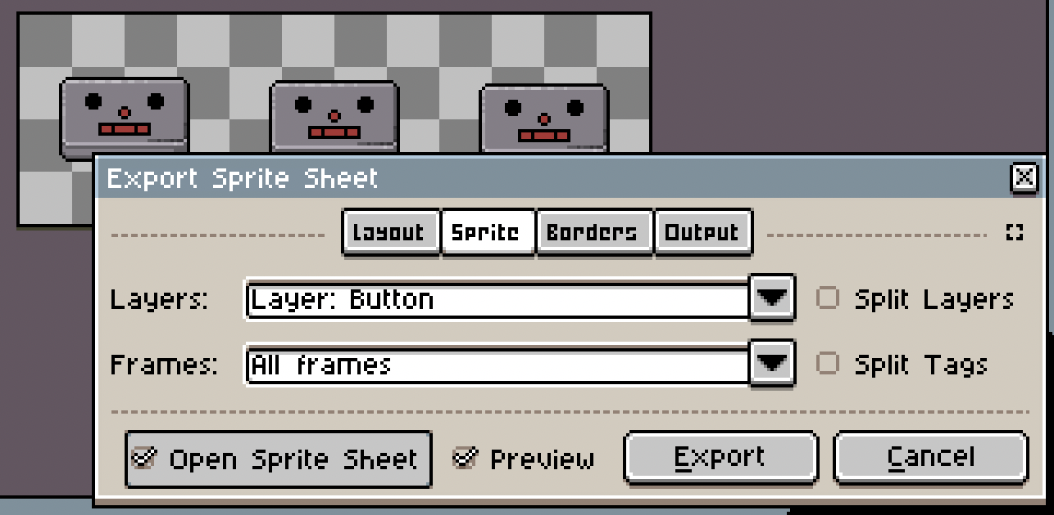
When you are ready to export your animation. Press (File/Export Sprite Sheet)
This should open a new page where you can alter the settings for the sheet. I recommend these settings to the right.

Slide 12
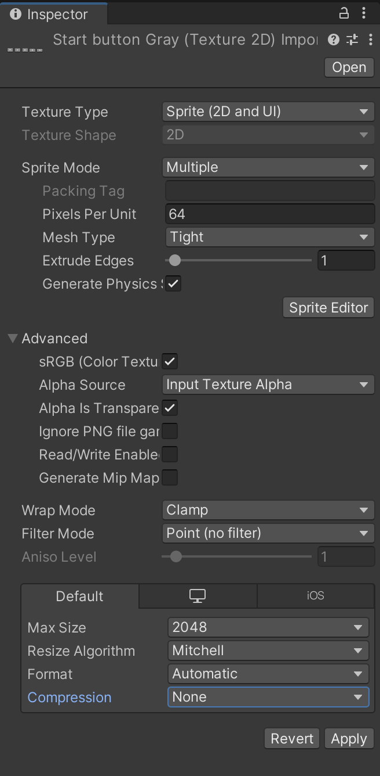
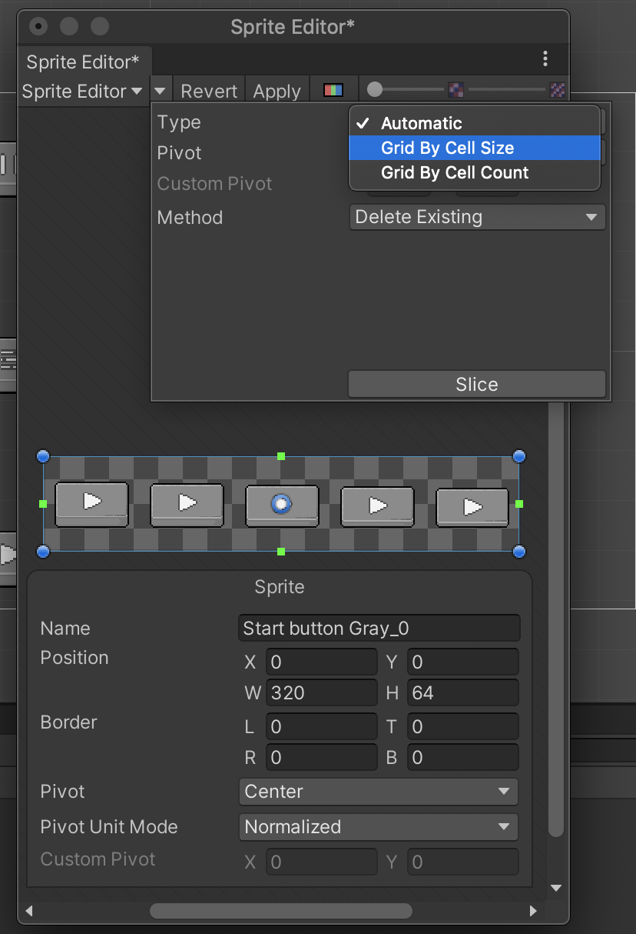
When you have added the sprite sheet to unity (and clicked it). It is very important that you select all these settings on the right.
Especially the compression as the sprites will look terrible in game.
Press APPLY
Then sprite editor
Highlight the sheet and then click the drop-down tab and select grid by cell size.
This will separate every single frame of the animation yet keep it in the same space.

Slide 13
Thank you and have fun!

